Slide 1
Gradient Descent and Cost Function

Slide 2
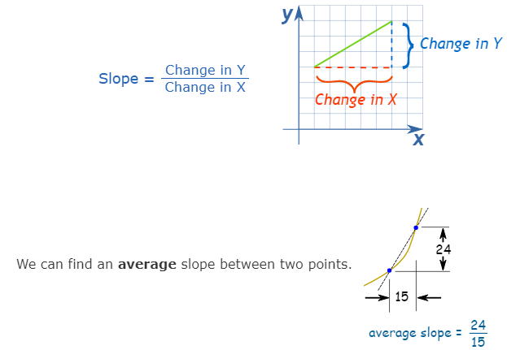
Slope
Recap of basic concepts

Slide 3
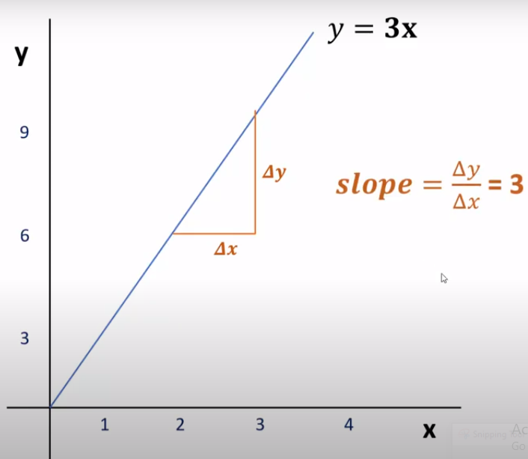
Recap of basic concepts
Case of a linear line
Delta y = 3 (9-6) {change in y}
Delta x = 1 (3-2) {change in x}

Slide 4
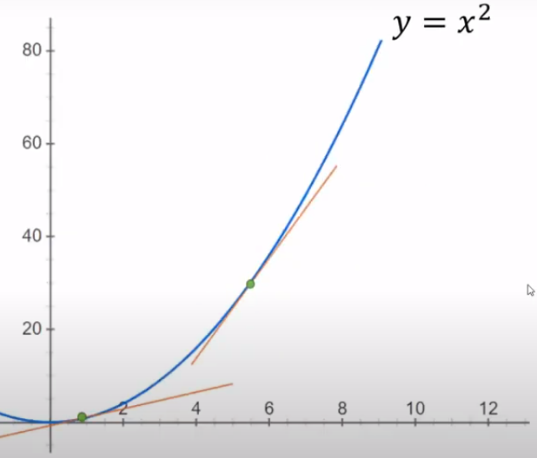
Slope
Recap of basic concepts
Case of a non-linear
Slope is not constant
Based on the point under observation,
the slope may vary
How to find the slope ?

Slide 5
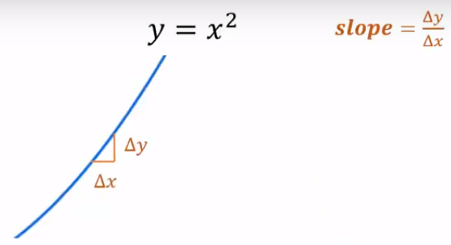
Slope
Recap of basic concepts
Zoom on the point, and it will look like a straight line
We can then use Delta y and Delta x, to calculate the slope

Slide 6
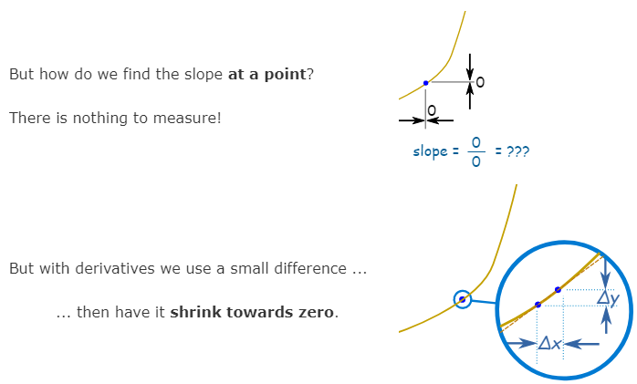
Slope
Recap of basic concepts

Slide 7
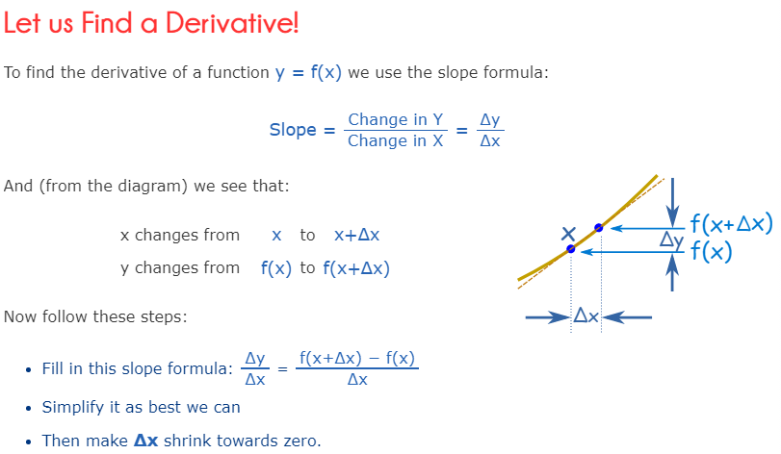
Slope and Derivative
Recap of basic concepts

Slide 8
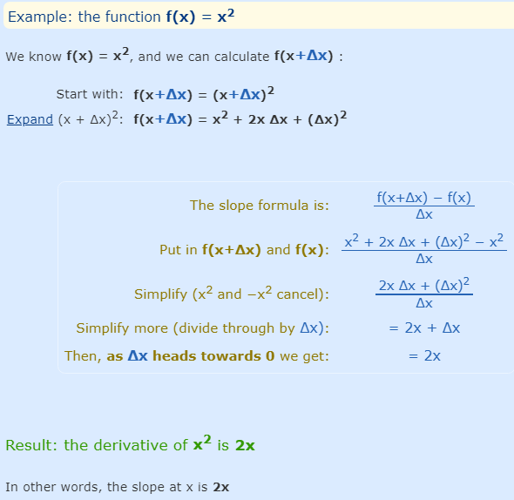
Derivative
Recap of basic concepts

Slide 9
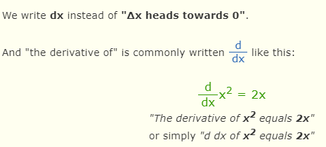
Derivative
Recap of basic concepts

Slide 10
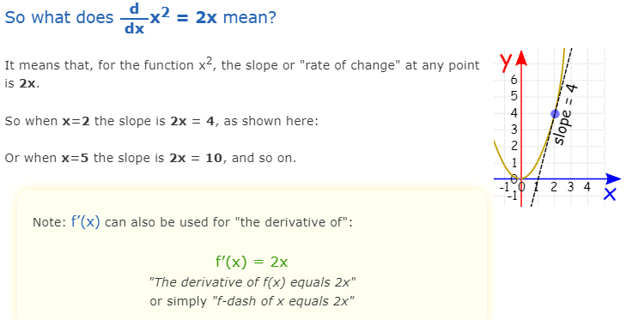
Slope and Derivative
Recap of basic concepts

Slide 11
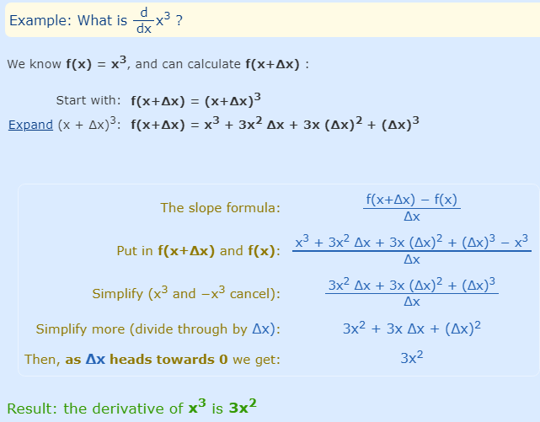
Derivative
Recap of basic concepts

Slide 12
Slope and Derivative
Recap of basic concepts
Geometrically, the derivative of a function can be interpreted as the slope of the graph of the function or, more precisely, as the slope of the tangent line at a point.
Its calculation, in fact, derives from the slope formula for a straight line, except that a limiting process must be used for curves.

Slide 13
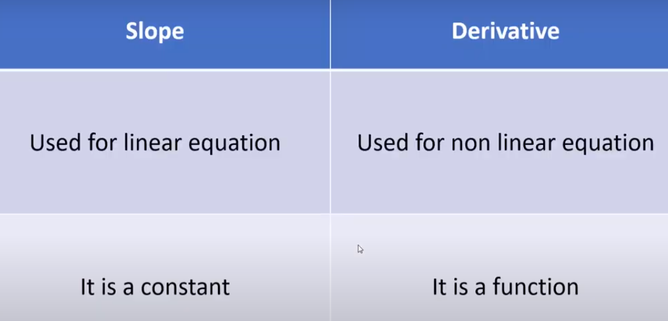
Slope and Derivative
Recap of basic concepts

Slide 14
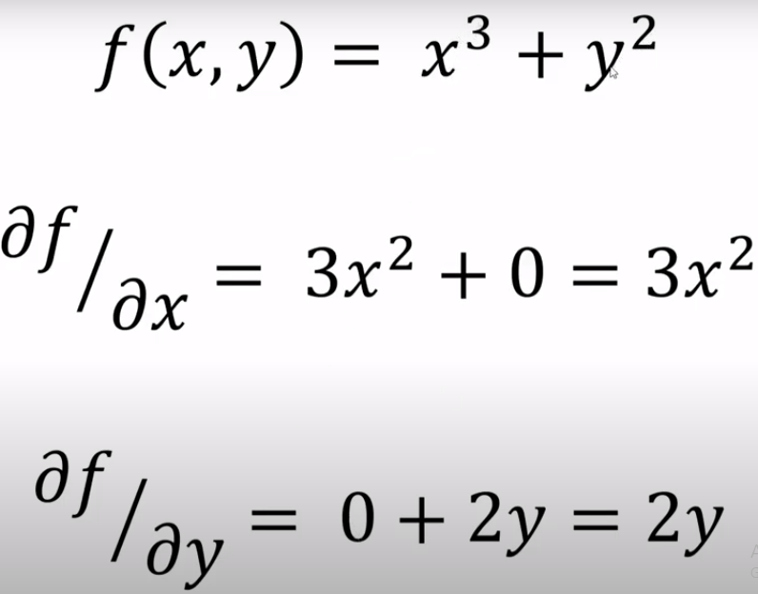
Partial Derivative
Recap of basic concepts

Slide 15
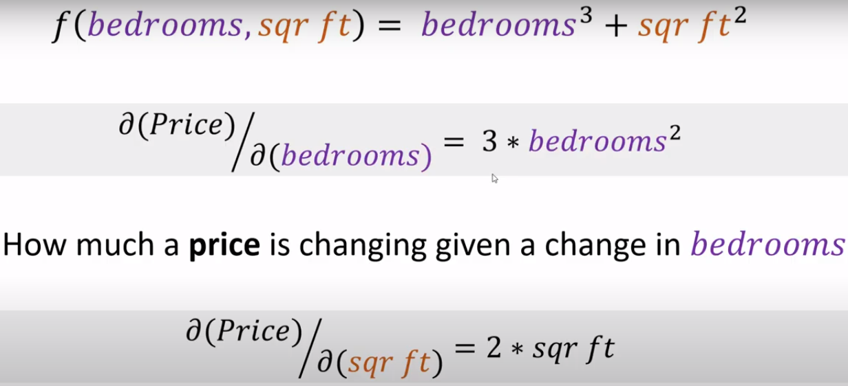
Partial Derivative and Gradient Descent
Recap of basic concepts
Partial derivative tells us that how much will be the effect of each weight change on the cost function.
E.g. how much price is changing, given number of bedrooms

Slide 16
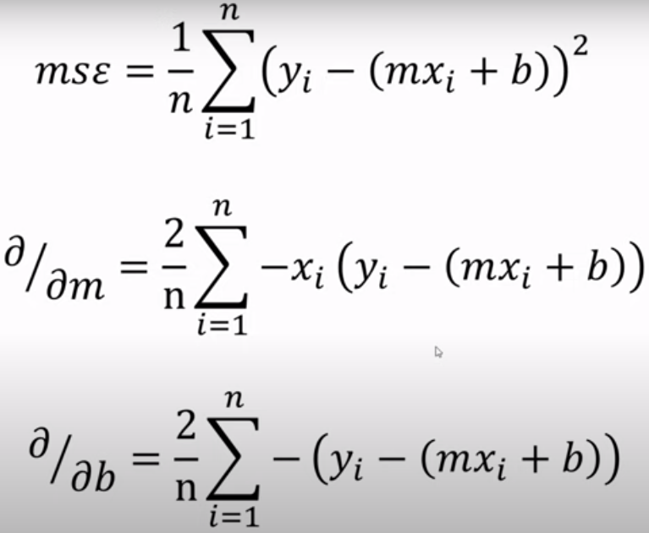
Recap of basic concepts

Slide 17
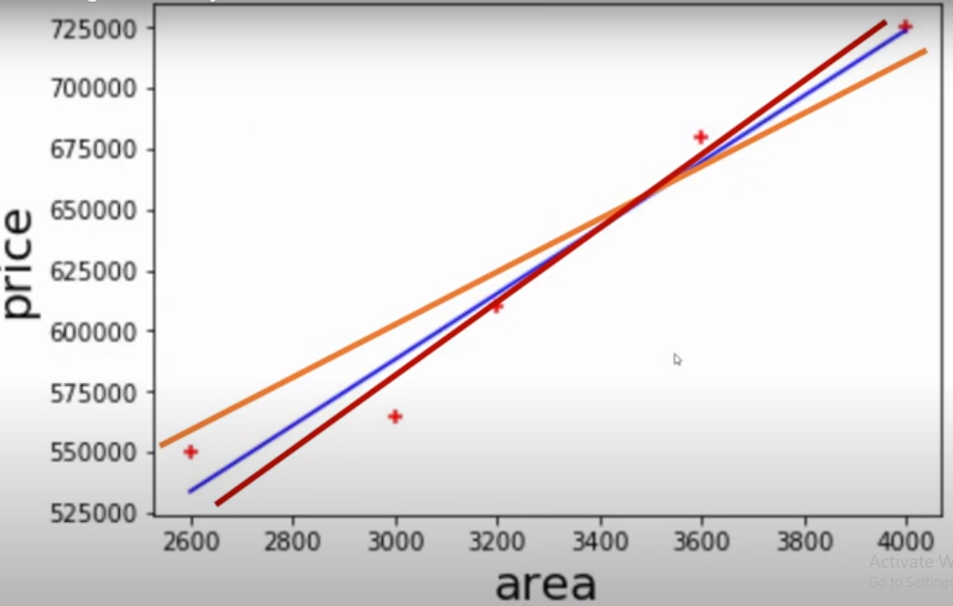
Possible linear regression lines

Slide 18
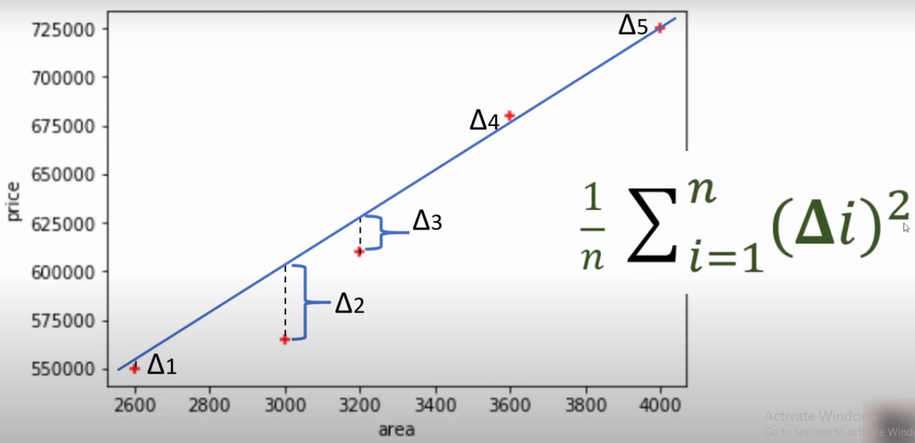
Mean square error

Slide 19
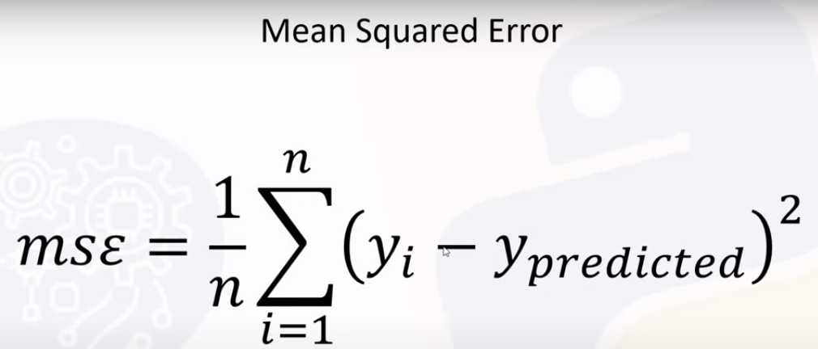
Mean square error

Slide 20
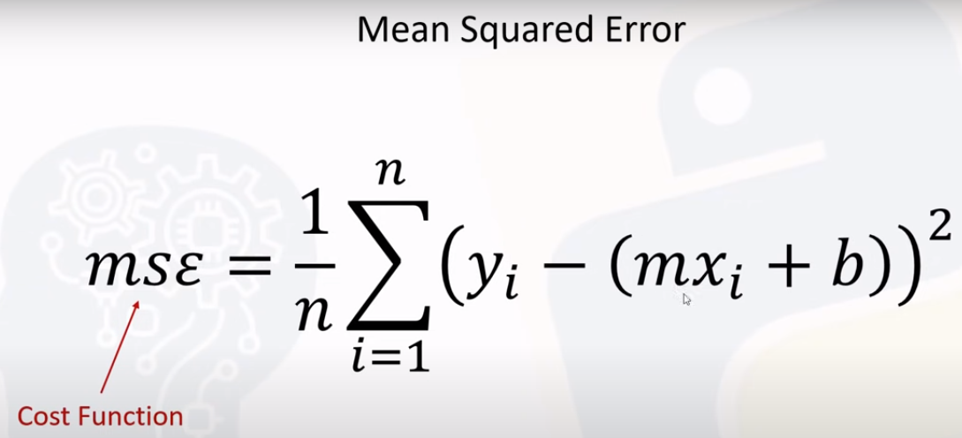
Mean square error

Slide 21
Gradient descent
There can be multiple regression lines that we can create with different values of slope and intercept.
But we cannot try every permutation and combination of slope and intercept.
The efficient approach will be to select the optimal line in minimum number of iterations.
Gradient descent is the algorithm that helps to find best fit line for given training dataset in minimum iterations.

Slide 22
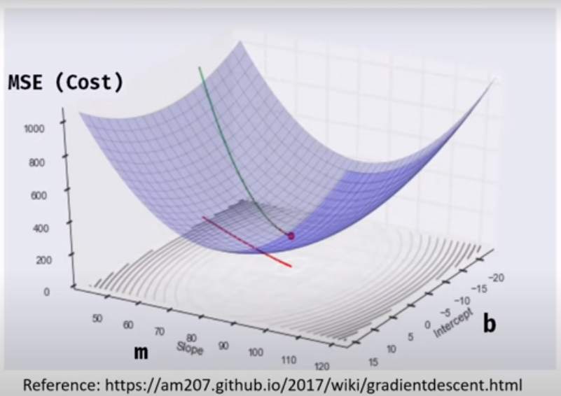
Gradient descent
Slope and intercept are plotted against MSE.
Different values of m and b will create a plane.
We start from any value of m and b, usually 0.
Then from that point cost is calculated and it is reduced with every mini-step.
We keep on taking small steps until we reach the minimum point.
At minima, the error is minimum.

Slide 23
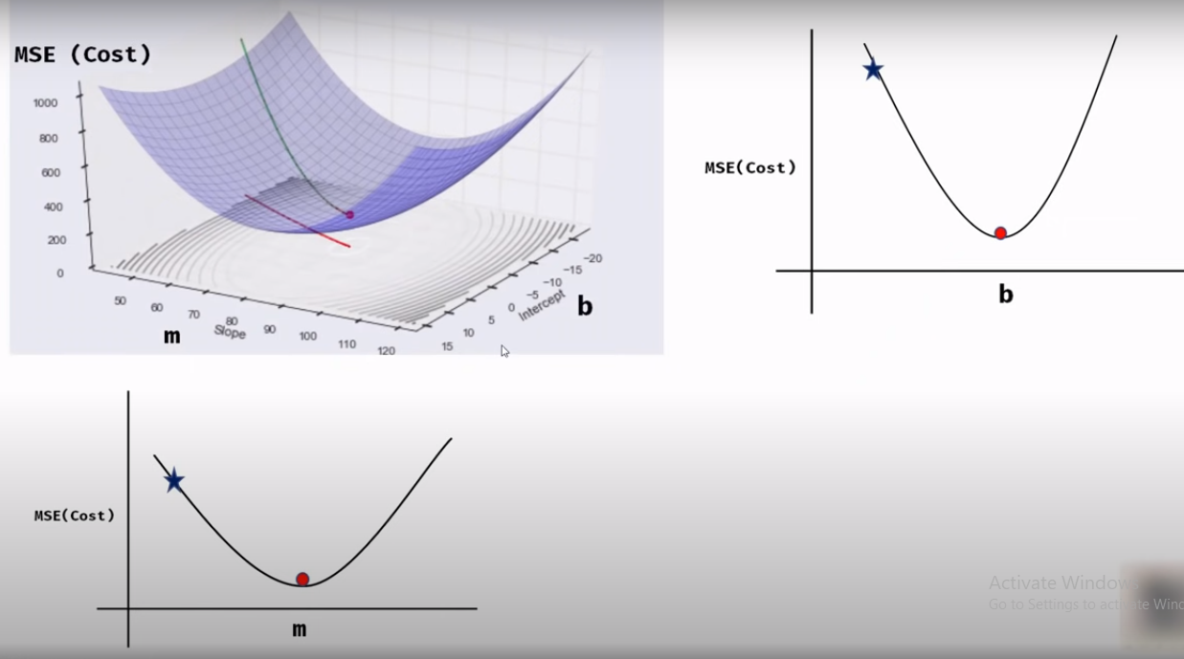
Gradient descent
Two views from m and b.

Slide 24
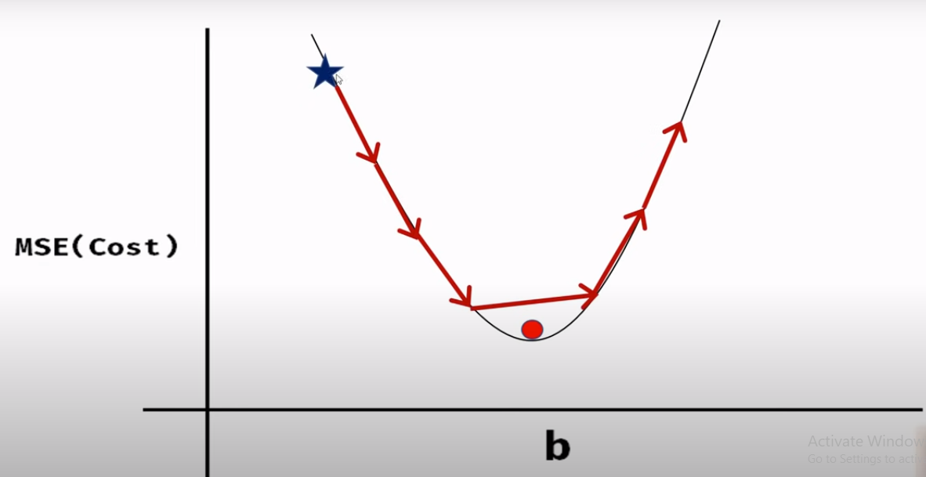
Gradient descent
If we take fixed size steps, we can miss global minima.
The gradient descent will never converge.

Slide 25
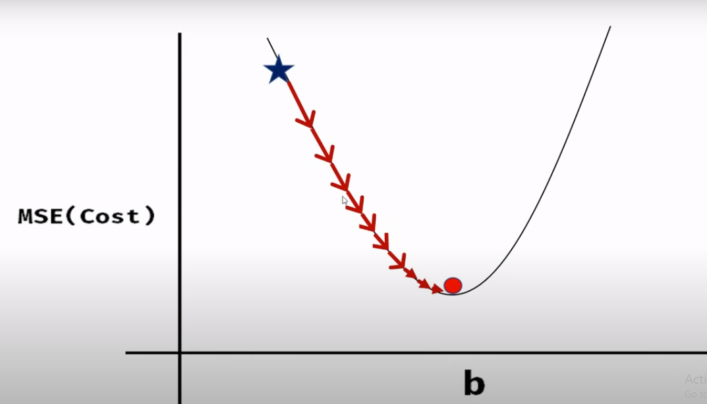
Gradient descent
Varying step sizes can help to achieve global minima.

Slide 26
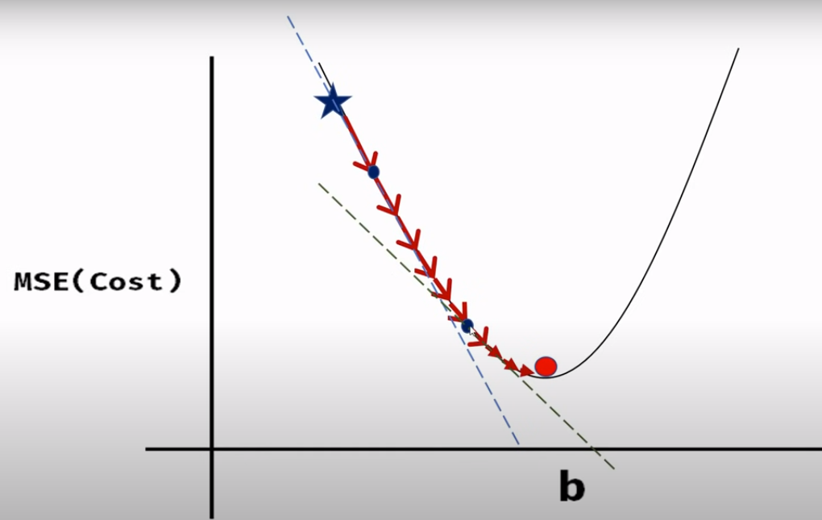
Gradient descent
Varying step sizes can be achieved by calculating slope at each point.
Partial derivative/Slope will tell in which direction we need to go.

Slide 27
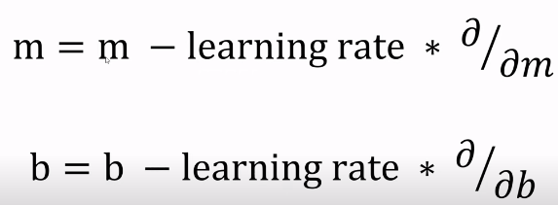
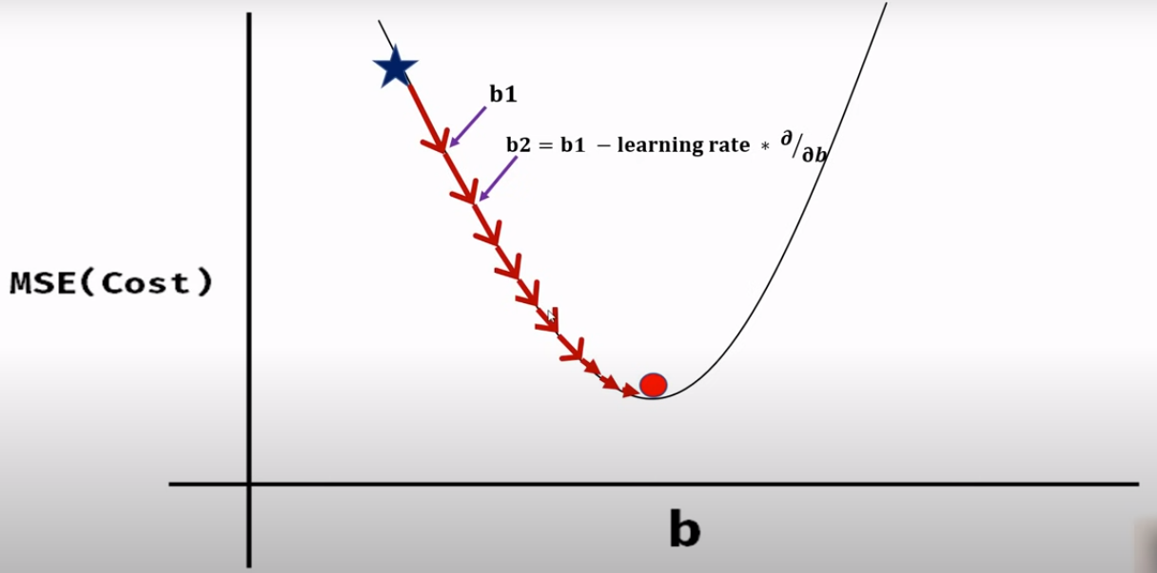
Gradient descent
Learning rate decides the step size.

Slide 28
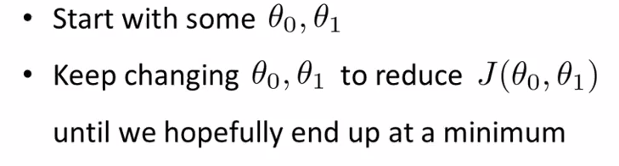

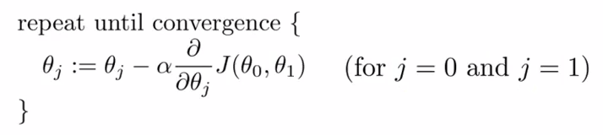
Gradient descent

Slide 29
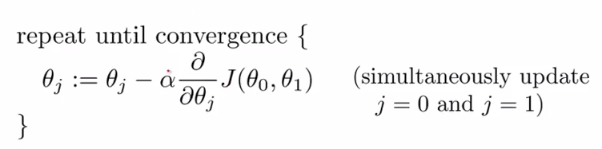
Gradient descent
Step size
Derivative Term
For simplicity, assume we have to minimize a function of one variable only J(θ₁)

Slide 30
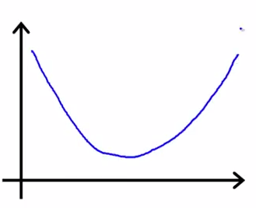
Gradient descent
J(θ₁) ; θ₁ is a real number
J(θ₁)
Slope of the line tangent to the function at point θ₁
θ₁
Initialize θ₁
Line has a positive slope, derivative is positive, so θ₁ moves towards the left

Slide 31
Gradient descent
J(θ₁) ; θ₁ is a real number
J(θ₁)
Slope of the line tangent to the function at point θ₁
θ₁
Line has a positive slope, derivative is positive, so θ₁ moves towards the left

Slide 32
Gradient descent
J(θ₁) ; θ₁ is a real number
J(θ₁)
θ₁
Line has a negative slope, derivative is negative, θ₁ minus a negative number adds something to θ₁ and moves it towards the right

Slide 33
Gradient descent
J(θ₁) ; θ₁ is a real number
J(θ₁)
θ₁
IF alpha is too small, gradient descent will take small steps, hence a long time to converge

Slide 34
Gradient descent
J(θ₁) ; θ₁ is a real number
J(θ₁)
θ₁
IF alpha is too large, gradient descent can overshoot the minimum and may fail to converge

Slide 35
Gradient descent
J(θ₁) ; θ₁ is a real number
J(θ₁)
θ₁
If is θ₁ already at minimum, the derivative term will be zero and the algorithm will converge in the first iteration

